Slide 1
For Live Session
Unit 9 Case Study of Breweries
Morgan Nelson
Michael Hedge

Slide 2
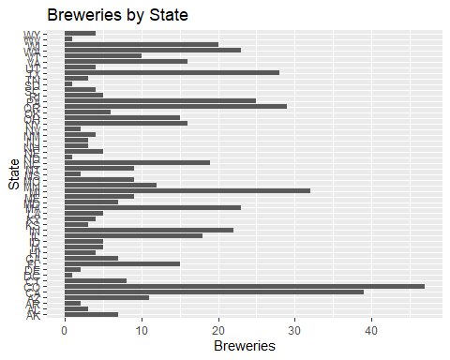
How many breweries per state

Slide 3
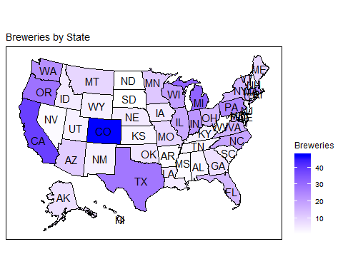
How many breweries per state

Slide 4
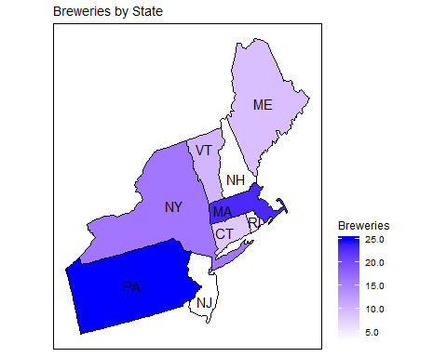
How many breweries per state

Slide 5
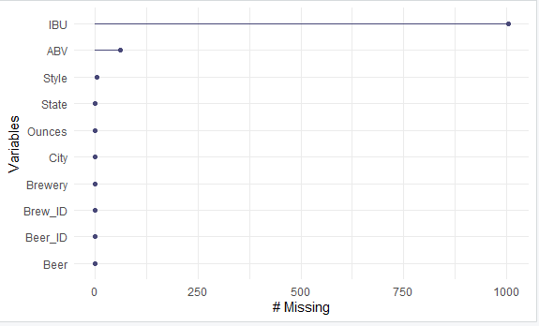
Missing data
Original data sets combined

Slide 6
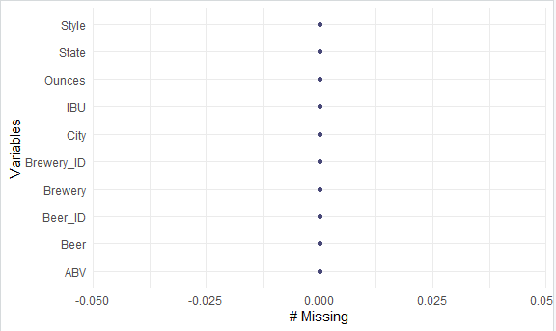
Missing data
Adjusted data set after filling missing values

Slide 7
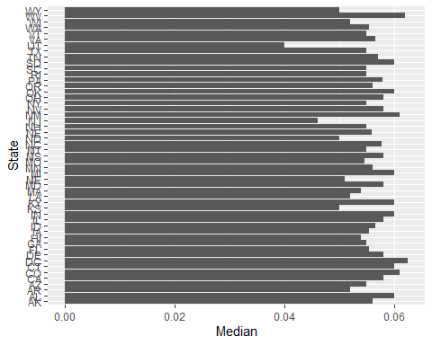
Median ABV per state

Slide 8
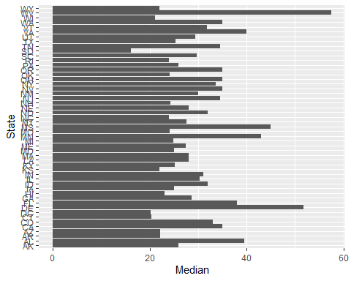
Median IBU per state

Slide 9
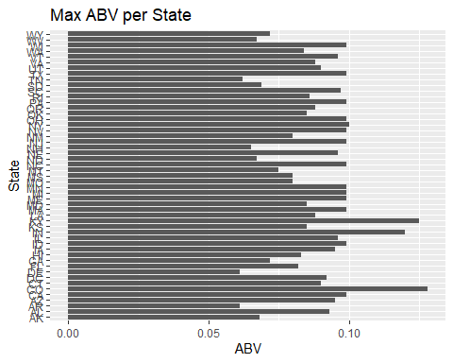
Max ABV

Slide 10
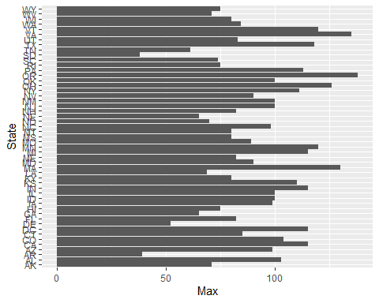
Max IBU

Slide 11
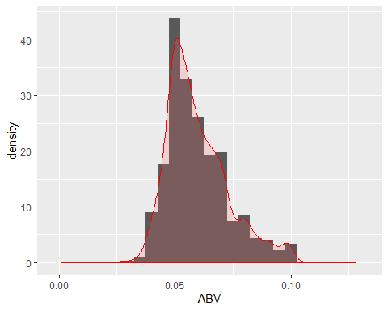
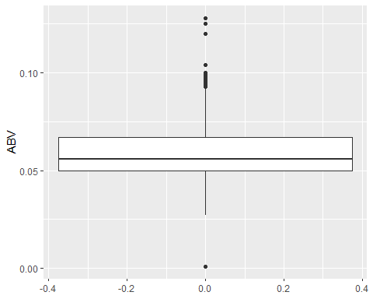
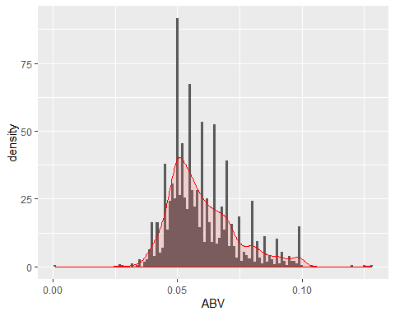
ABV stats and distribution

Slide 12
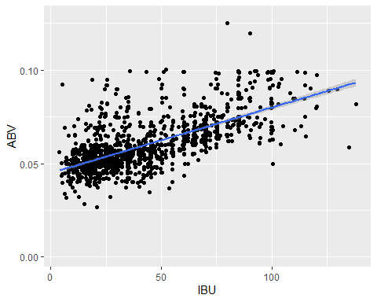
ABV to IBU

Slide 13

Part 3 ($≤1 hour$)
Takeaways
and
questions!

